Slide 1






CST Result Management System
Supervisor: Mr.Tshering
Dechen Wangmo
Sonam Namgyel
Sonam Tobgay
Tshewang Rinzin
30/08/2014

Slide 2


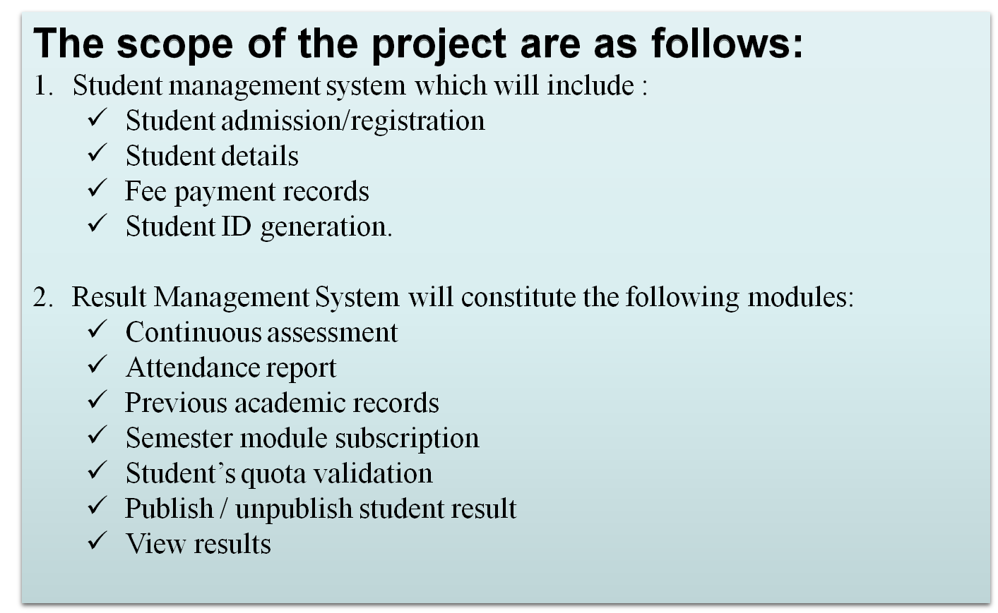


Slide 5
Thank You

Slide 6
Thank You
Kingsoft Office
Make Presentation much more fun

